Slide 1
Media 175
Principles of Digital
Photography
Photographer: Martha Cooper
Presented by Luke Kisena

Slide 2
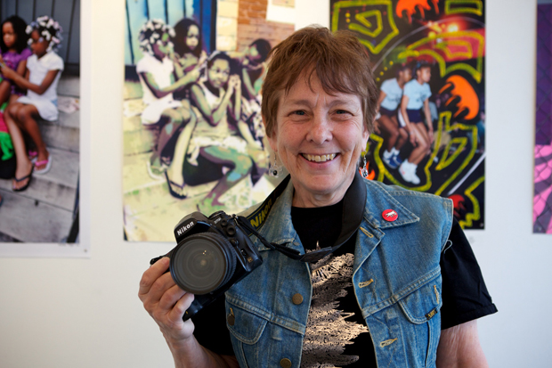
Martha Cooper
Born in the 1940s in Baltimore, Maryland
“Many times I tried to develop a decent looking tag but failed miserably.
It never looked cool. I found out how hard it was to repeatedly write with style.”
Martha Cooper

Slide 3
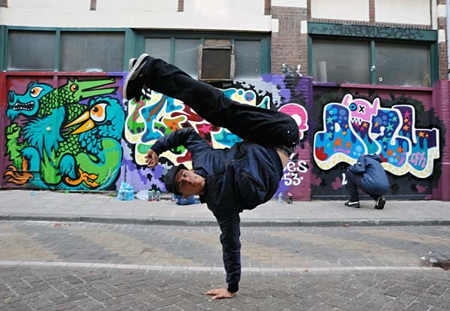
Martha Cooper focused on urban settings, particularly on graffiti and the hip-hop culture.
Photo by: Martha Cooper

Slide 4

“ I shot tags because I wanted a record of them. I wasn't trying to make my own art. I was trying to figure out how they differed from each other and what similarities there were. I defined categories and filed them accordingly. In some cases I wanted to see their context but mostly I just wanted to study what they looked like and to allow others to study them in the future. I was using my camera as a very efficient tool to make a record of something that would otherwise be lost.”
Photo by Martha Cooper
Martha Cooper

Slide 5
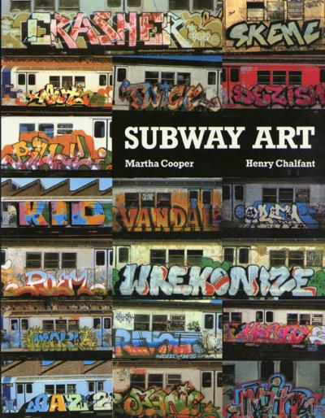
When I was eight years old my uncle gave me this book. Her images mixed with this style of art molded me into the artist that I am.

Slide 6

Photo by: Martha Cooper

Slide 7
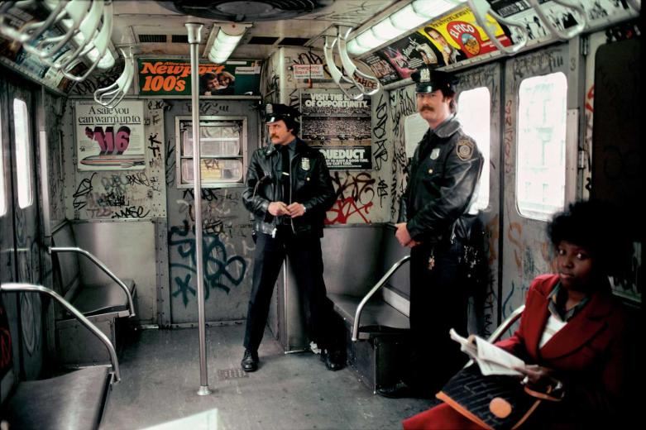
Photo by: Martha Cooper

Slide 8
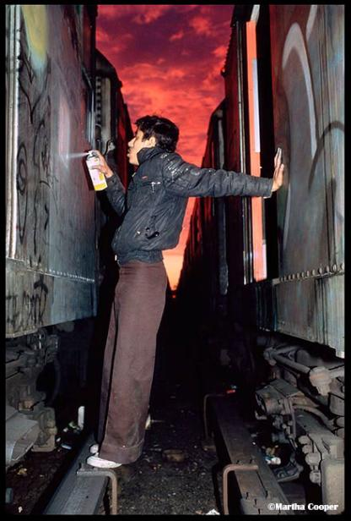
Photo by: Martha Cooper

Slide 9
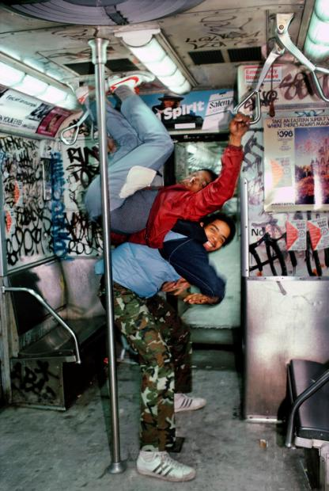
Photo by: Martha Cooper

Slide 10
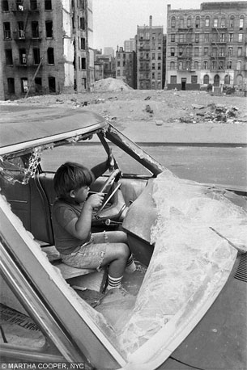
Photo by: Martha Cooper

Slide 11
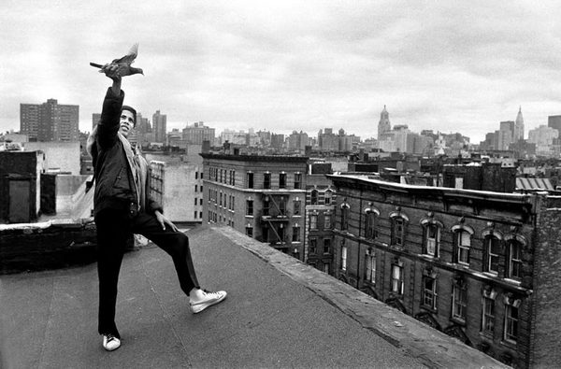
Photo by: Martha Cooper

Slide 12
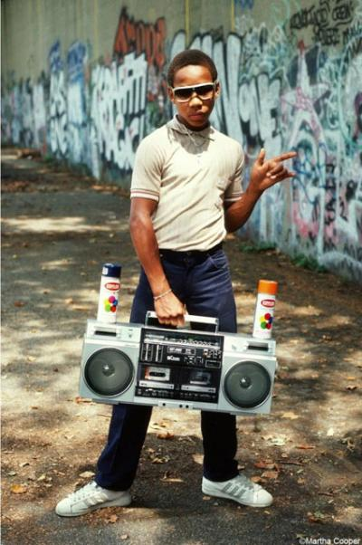
Photo by: Martha Cooper

Slide 13

Photo by: Martha Cooper

Slide 14
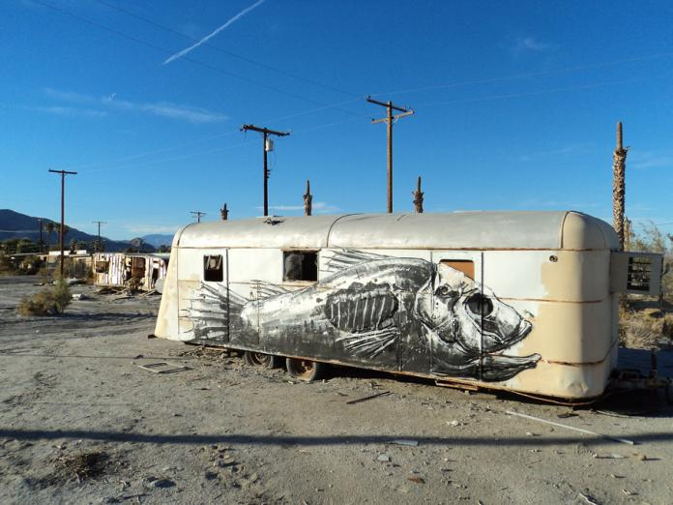
Photo by: Martha Cooper

Slide 15
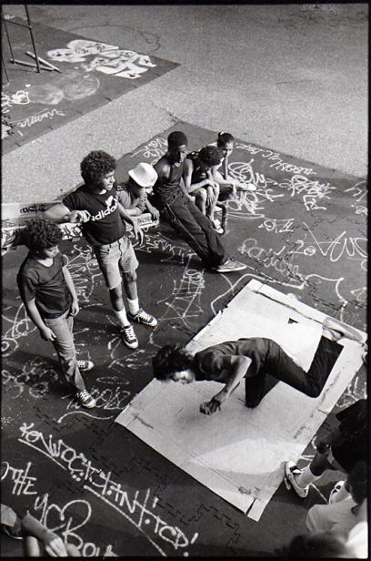
Photo by: Martha Cooper

Slide 16
The End resources
http://en.wikipedia.org/wiki/Martha_Cooper
https://www.google.com/search?q=martha+cooper+photos&hl=en&prmd=imvnso&tbm=isch&tbo=u&source=univ&sa=X&ei=0RQWT6uAGOTmiAKlz8S6Dw&sqi=2&ved=0CCMQsAQ&biw=1440&bih=767

